Slide 1
OPTIMIZING CUSTOMER EXPERIENCES WITH PERSONALITY INSIGHTS AND SEGMENTATION
PRESENTED BY: INDU SRI GAMIDI

Slide 2
PROBLEM STATEMENT
Customers behave differently across the customer journey (awareness, purchase, post-purchase).
A one-size-fits-all approach leads to poor customer experiences.
Personalized approaches can improve retention, loyalty, and customer lifetime value (CLV).

Slide 3
PROJECT GOALS
1.Data science to analyze customer behavior.
2.Predict key customer outcomes.
3.Provide actionable insights through interactive visualizations.

Slide 4
Key Objectives
Data Acquisition & Preparation – Ensure accurate analysis.
Customer Segmentation – Group customers for targeted strategies.
Exploratory Data Analysis – Identify important patterns.
Predictive Modeling – Forecast customer behavior.
Interactive Visualization – Create Power BI dashboards.
Insight Generation & Reporting – Provide strategic recommendations.
Integration & Deployment – Implement insights into business.
Performance Monitoring – Maintain model accuracy over time.

Slide 5
DATASET DESCRIPTION
This dataset contains 2,240 entries and 29 columns, representing customer data from a marketing campaign. It includes demographic details, purchasing behaviors, and responses to marketing efforts.
Key Columns:
Customer Demographics:
ID: Unique customer identifier.
Year_Birth: Year of birth.Education: Level of education (Graduation, PhD, etc.).
Marital_Status: Relationship status (Single, Married, Together, etc.).
Income: Household income.
Kidhome: Number of small children in the household.
Teenhome: Number of teenagers in the household.
Dt_Customer: Date when the customer was enrolled.
2. Purchase Behavior:
Recency: Number of days since last purchase.
MntWines, MntFruits, MntMeatProducts, MntFishProducts, MntSweetProducts, MntGoldProds: Money spent on different product categories.
NumDealsPurchases: Number of purchases using discounts.
NumWebPurchases, NumCatalogPurchases, NumStorePurchases: Purchases made through different channels.NumWebVisitsMonth: Number of website visits in the last month.
3. Marketing Campaign Responses:
AcceptedCmp1 to AcceptedCmp5: Whether the customer accepted past campaigns.
Response: If the customer accepted the most recent campaign.
Complain: Whether the customer filed a complaint.Z_CostContact, Z_Revenue: Standardized cost and revenue variables.

Slide 6
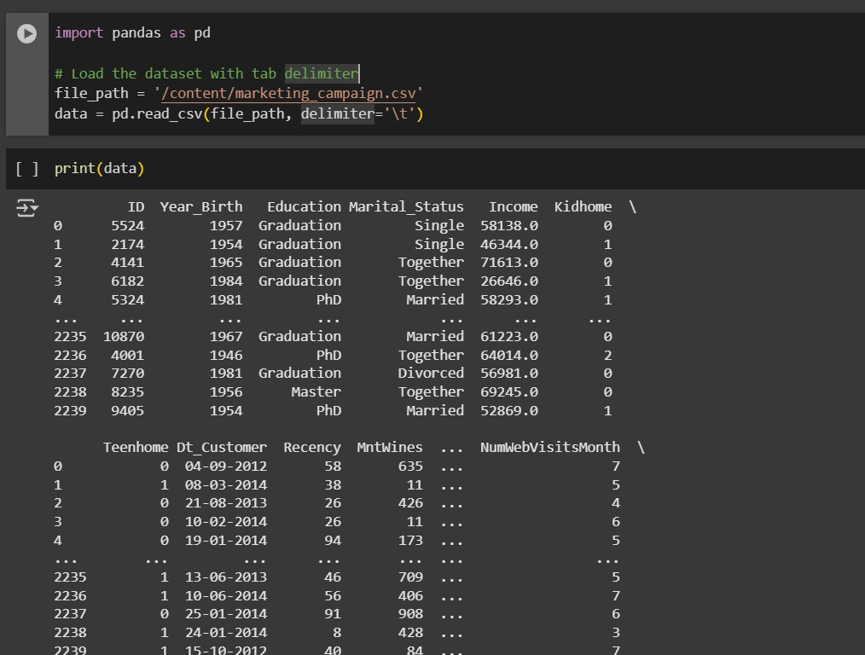
Step : 1 - imports the pandas library and loads a CSV file (marketing_campaign.csv) using a tab (\t) delimiter into a DataFrame named data.

Slide 7
step 2:
This code visualizes missing values in the dataset using a heatmap.
It uses sns.heatmap() from Seaborn, where yellow spots indicate missing values, and
plt.show() displays the plot.
3. Income has 24 missing values

Slide 8
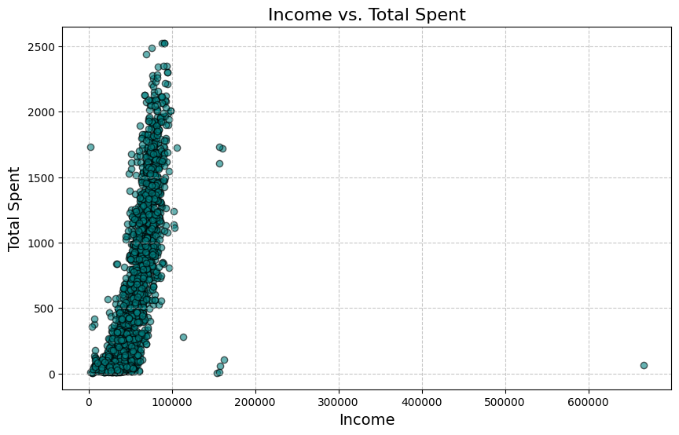
EDA:
EDA :
This scatter plot visualizes Income vs. Total Spent by customers.
Most data points are clustered around lower income levels (under 100,000).
A general positive trend suggests that higher income individuals tend to spend more.
A few extreme outliers exist, particularly one customer with an income above 600,000 but very low spending.
The density of points at lower income levels suggests a majority of customers fall in this range.

Slide 9
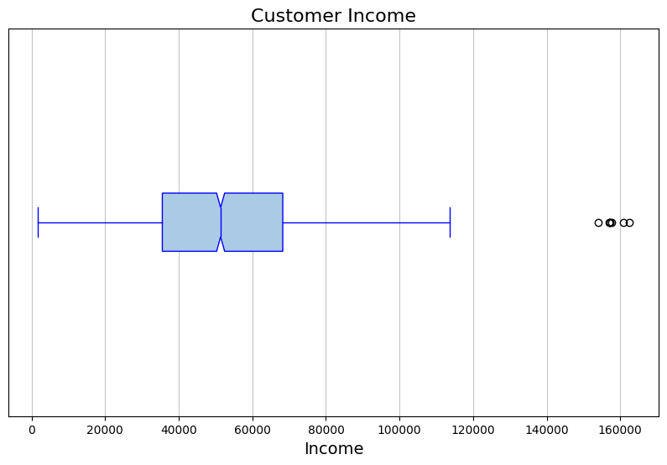
This is a box plot of customer income. Here’s what you can observe:
The box represents the interquartile range (IQR), showing the middle 50% of the data.
The median is the line inside the box.
The whiskers extend to the minimum and maximum values within 1.5 times the IQR.
The outliers (black circles) are incomes that fall beyond the whiskers, indicating unusually high values.

Slide 10
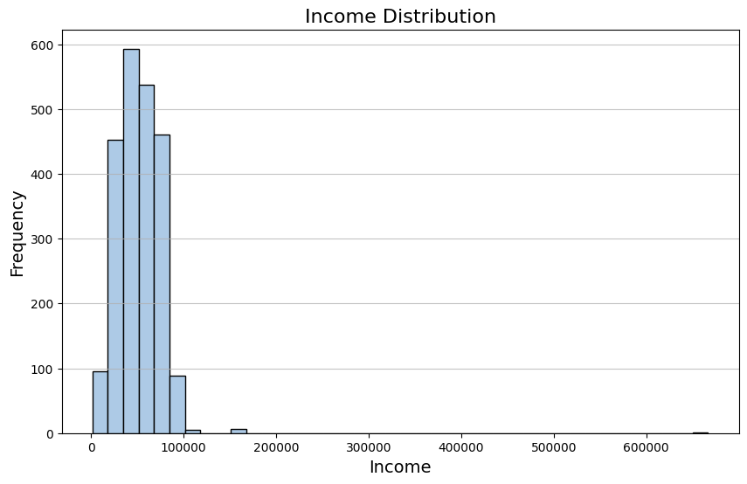
This is a histogram showing the Income Distribution of customers. Here’s what it indicates:
Most of the income values are concentrated in the lower range (under 100,000).
There are a few extreme outliers with significantly high income (above 200,000).
The distribution appears right-skewed, meaning most customers have lower incomes, while a few have very high incomes.

Slide 11
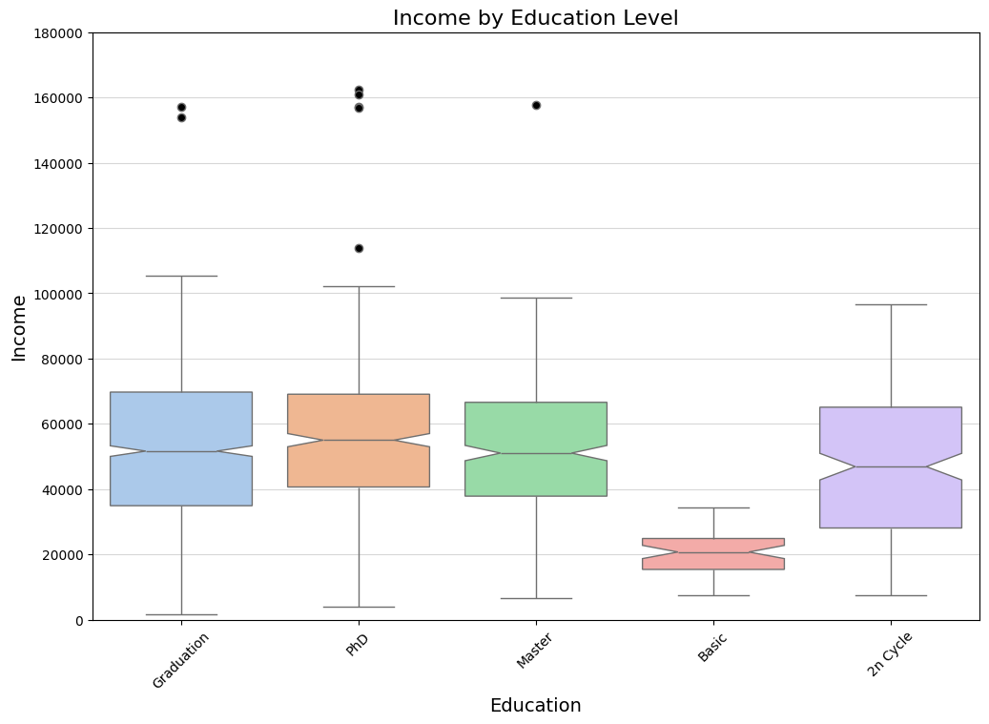
Box plot :
X-axis (Education Level):
The different education levels include Graduation, PhD, Master, Basic, and 2n Cycle.
Y-axis (Income):
Represents the annual income of customers.
Box Plot Interpretation:
The box represents the interquartile range (IQR), showing the middle 50% of incomes for each education level.
The horizontal line inside the box represents the median income.
The whiskers extend to the minimum and maximum values within 1.5 times the IQR.
The black dots above the whiskers are outliers, indicating extreme income values.
Result Analysis:
Higher education levels (Graduation, PhD, Master, and 2n Cycle) generally correlate with higher median incomes.
Basic education level has the lowest income distribution and a much smaller range.
Income distribution is similar for Graduation, PhD, Master,
and 2n Cycle, but slight variations exist in medians and
outliers.
Outliers in higher education groups indicate some
Individuals have exceptionally high incomes.

Slide 12
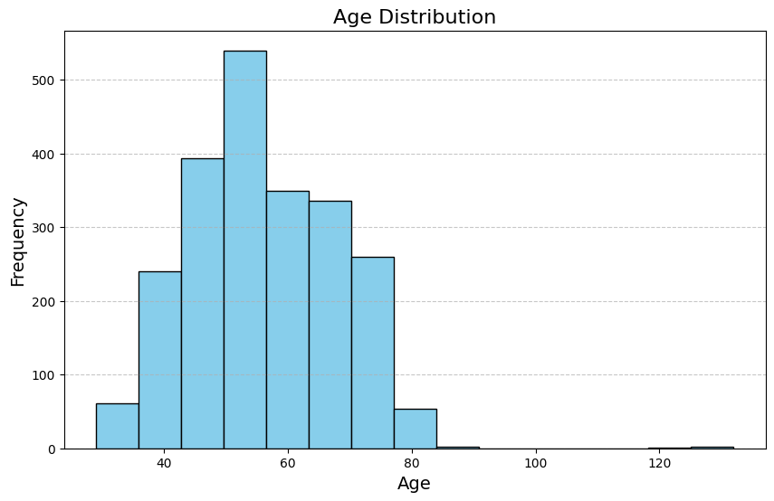
This histogram represents the Age
Distribution of customers from the dataset.
X-axis (Age):
Represents the age of customers, calculated from the Year_Birth column.
The values range approximately from 30 to 130, but extreme values beyond 100 are likely outliers.
Y-axis (Frequency):
Represents the number of customers falling within each age group.
Distribution Pattern:
The majority of customers are between 40 and 70 years old, with the highest concentration around the 50s.

Slide 13
THANK YOU

